Slide 1
Lightweight Cryptography (CRYE6135) · Session 2, Project 2
Gate Equivalents & Multi-Technology ASIC Synthesis
Hand-Counted Gate Analysis vs. Yosys Standard-Cell Synthesis in 45 nm, 130 nm & 180 nm
Group 2

Slide 2
1. Problem Statement · Passive UHF RFID Tags
Why Standard Block Ciphers Exceed Tag Limits
RFID Security Ceiling
2,000 GE (1.0×)
2,000 GE
Maximum silicon budget for cryptographic logic.
HIGHT Block Cipher
3,048 GE (1.5×)
Exceeds maximum tag security budget by 1,048 GE.
Max Security Gate Budget
Only 200 to 2,000 GE available out of 1,000 to 10,000 total tag gates.
Compact AES-128
3,400 GE (1.7×)
Exceeds maximum tag security budget by 1,400 GE.

Slide 3
2. Project Scope · Candidate RTL Circuits
Four Hardware Primitives Investigated
1. PRESENT 4-Bit S-Box
2. 32-Bit XOR-Rotate
16-entry non-linear substitution table.
ARX primitive with 7-bit fixed shift.
3. 64-Bit PRESENT Round
4. 8-Bit AES S-Box LUT
64-bit key XOR with 16 parallel S-boxes.
256-entry lookup table baseline.

Slide 4

3. Hardware Metric · ASIC Area Normalization
Gate Equivalents (GE) & Elementary Weights
Gate Type | Textbook Weight
Wire / Bit Permutation | 0.00 GE
Inverter (INV) | 0.67 GE
2-Input NAND2 / NOR2 | 1.00 GE
2-Input AND2 / OR2 | 1.33 GE
2-Input XOR2 | 2.00 GE
Gate Equivalent Formula
1 GE equals the silicon area of one 2-input NAND gate in the same technology library.

Slide 5
4. Hand-Counted Analysis · Non-Linear S-Box
4-Bit PRESENT S-Box: 31 Gates = 41.0 GE
14
8
4
4 + 1
AND2 Gates
OR2 Gates
XOR2 Gates
INV + NAND2
18.67 GE
10.67 GE
8.00 GE
3.67 GE
Verified against all 16 PRESENT S-box outputs (C, 5, 6, B, 9, 0, A, D, 3, E, F, 8, 4, 7, 1, 2)
41.0 GE

Slide 6
5. Hand-Counted Analysis · Full Round & Free Wiring
PRESENT Round (784 GE) & XOR-Rotate (64 GE)
1. addRoundKey
2. sBoxLayer
3. pLayer Wires
64 × XOR2 gates
16 × 41.0 GE S-boxes
64-bit wire routing
128.0 GE
656.0 GE
0.0 GE
32-Bit XOR-Rotate: 32 XOR2 gates (64 GE) + 7-bit wire shift (0 GE)
64.0 GE

Slide 7



6. Experimental Setup · Open-Source EDA Flow
Yosys + ABC Synthesis Across Three PDKs
Three Real Libraries
Reference Vectors
Equivalence Proof
Nangate 45 nm, SkyWater 130 nm, GlobalFoundries 180 nm PDKs.
PRESENT-80 model passes all 4 official standard test vectors.
Every synthesized gate netlist is formally proven equal to RTL.

Slide 8
7. Experimental Results · Gate Equivalents (GE)
Hand Count vs. Synthesized Gate Equivalents
Hardware Design | Hand Count | Nangate 45 nm | SkyWater 130 nm | GF 180 nm
32-Bit XOR-Rotate | 64.0 GE | 64.0 GE | 74.7 GE | 76.8 GE
PRESENT S-Box (4-Bit) | 41.0 GE | 24.0 GE | 26.0 GE | 28.2 GE
PRESENT Round (64-Bit) | 784.0 GE | 579 GE | 590 GE | 666 GE
AES S-Box (8-Bit LUT) | — | 567 GE | 624 GE | 657 GE
Combinational logic only: 64-bit state register adds ~340–370 GE (64 DFF cells).

Slide 9
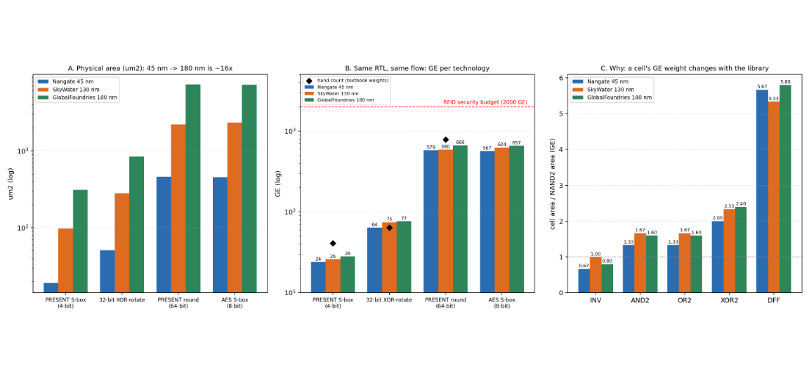
8. Multi-Technology Plot · Area, GE & Cell Weights
45 nm vs. 130 nm vs. 180 nm Synthesis Comparison

Slide 10
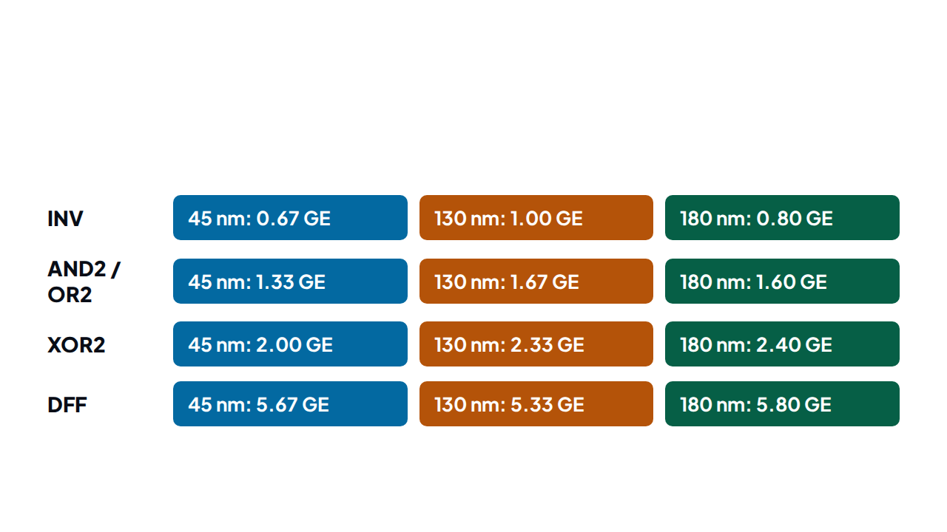
9. Root Cause Analysis · Panel C Breakdown
Why a Cell's GE Weight Changes Per Library

Slide 11
10. Core Engineering Question · Cross-Technology Limits
Why GE Numbers Must Not Be Compared Directly
1. Real Silicon Area Changes ~16×
2. Same RTL Gives 15–20% Different GE
•
16× Die Shrink: 180 nm to 45 nm physical area.
•
Non-Uniform Cells: XOR2 costs 2.00 GE to 2.40 GE.
•
Exercise 4 Proof: 2,000 GE is 3,000 µm² vs 1,000 µm².
•
PRESENT Round Shift: 579 GE (45nm) vs 666 GE (180nm).
•
Physical Cost: Wafer cost and capacitance depend on µm².
•
Tool Version Effect: ABC mapper shifts GE on same PDK.

Slide 12
What We Found & What Surprised Us
41% Smaller via Synthesis
0 GE Wire Permutations
24× Smaller Than AES LUT
S-box drops from 41 GE by hand to 24 GE in 45 nm.
PRESENT pLayer and 7-bit rotation use zero logic gates.
PRESENT S-box takes 24 GE vs 567 GE for AES LUT.
Live Yosys Demo & Questions · Thank You!

